Slide 1
Wendy Hilberman Executive Director
Sonoma County Public Library Foundation

Slide 3
Sonoma County Public Library Foundation
Founded in 1988

Slide 4
Strengthening the ability of the Sonoma County Library to serve our community by raising funds to support the library, and to promote the use of library resources, enthusiasm for reading, and increased literacy for all Sonoma County residents.

Slide 5
Who says libraries are dying?

Slide 6
Not dying
Just evolving…

Slide 7
There were 1.5 billion in-person visits to public libraries across the United States.
Notes:
This was a 10-year increase of 20.7 percent.

Slide 8
Libraries are at the heart of our communities
A resource for people of any age to find what they need to help improve their quality of life.

Slide 9
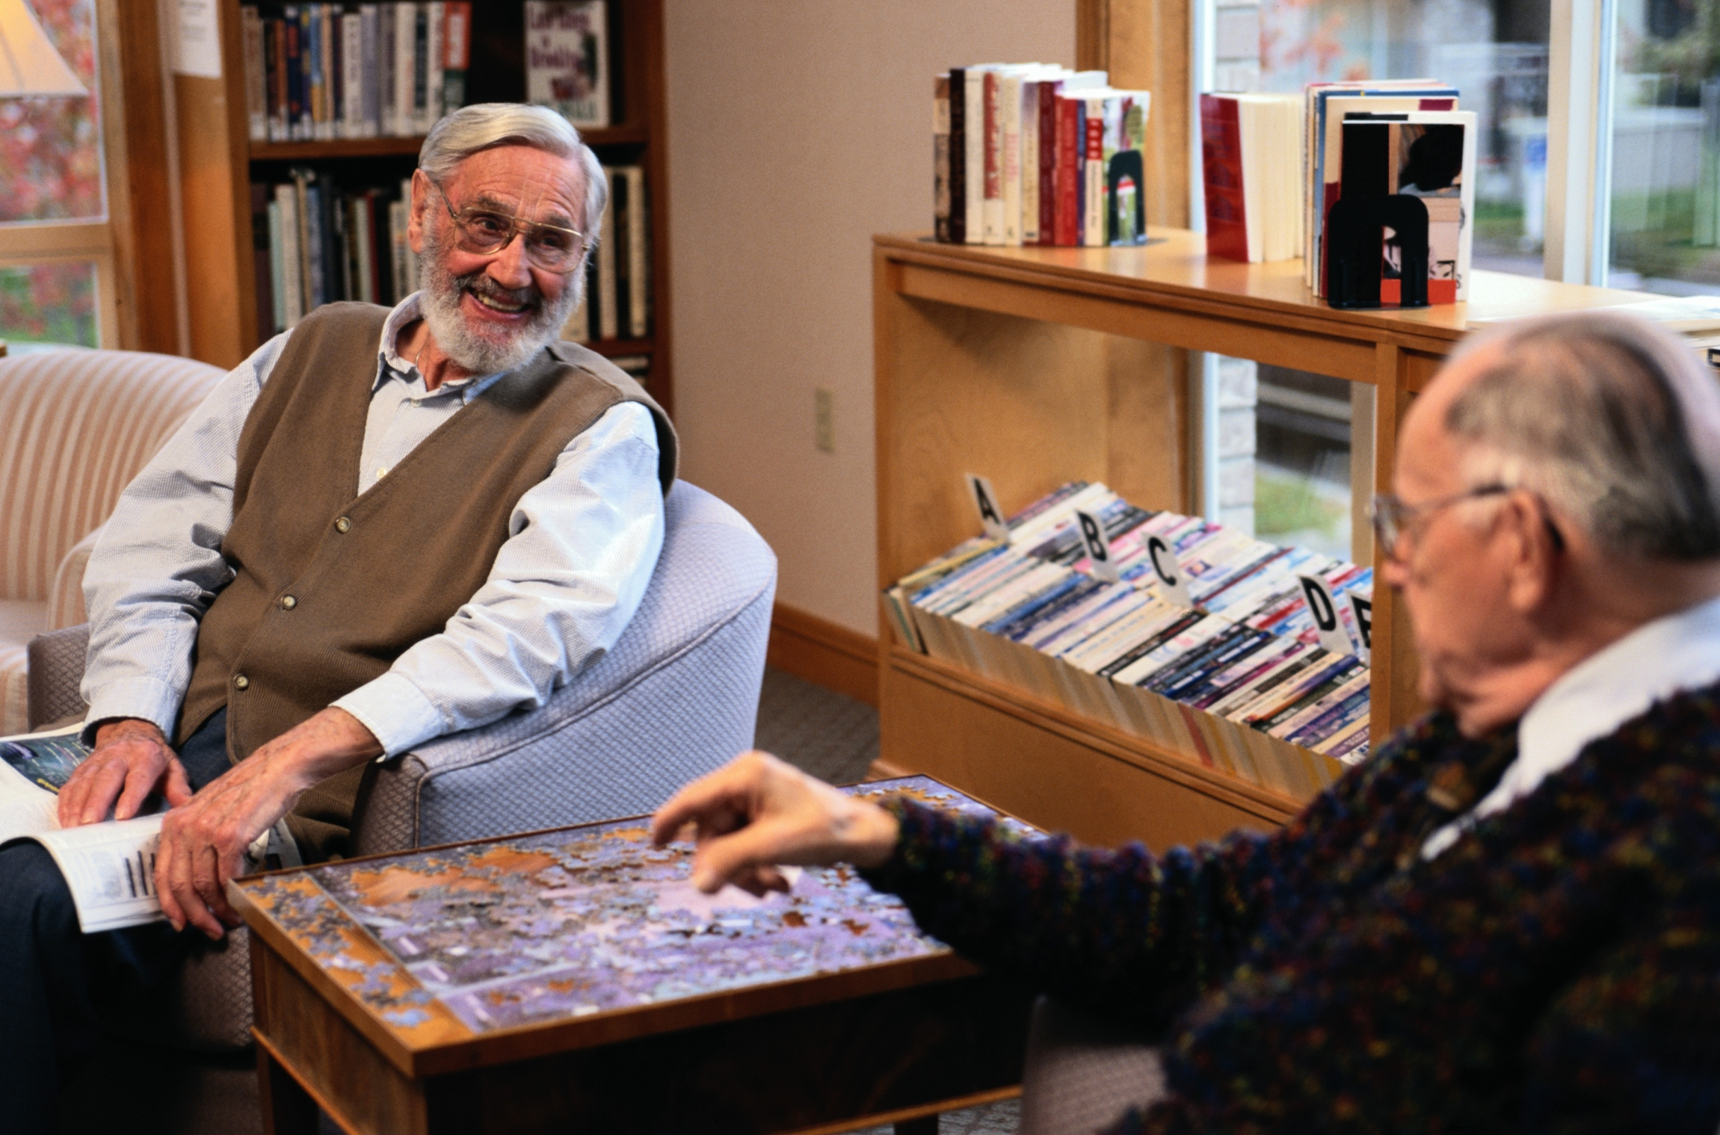
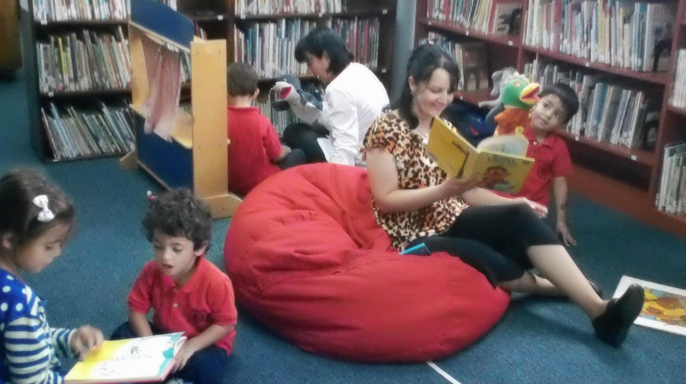
Libraries are community centers
“People may go to the library looking mainly for information, but they find each other there.”

Slide 10
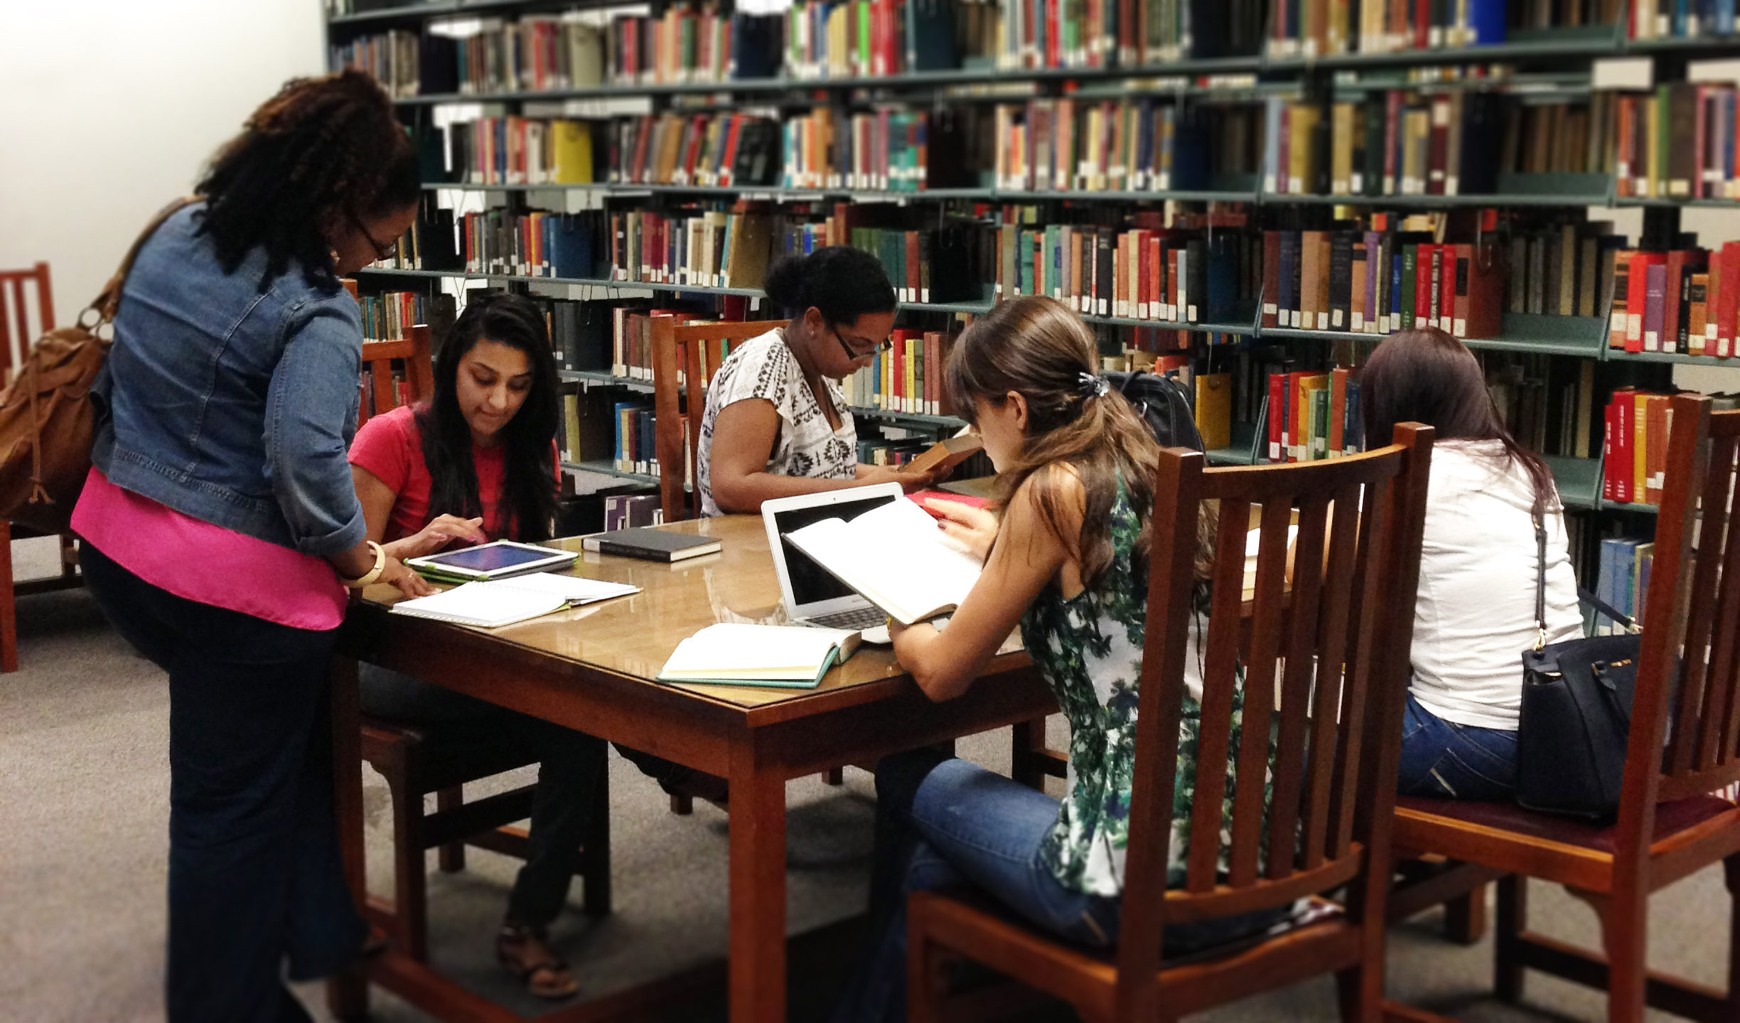
Libraries are technology hubs
Offer programs in technology, career and college readiness, innovation and entrepreneurship – all 21st-century skills, essential for success in today’s economy.

Slide 11
BRIDGING THE DIGITAL DIVIDE

Slide 12
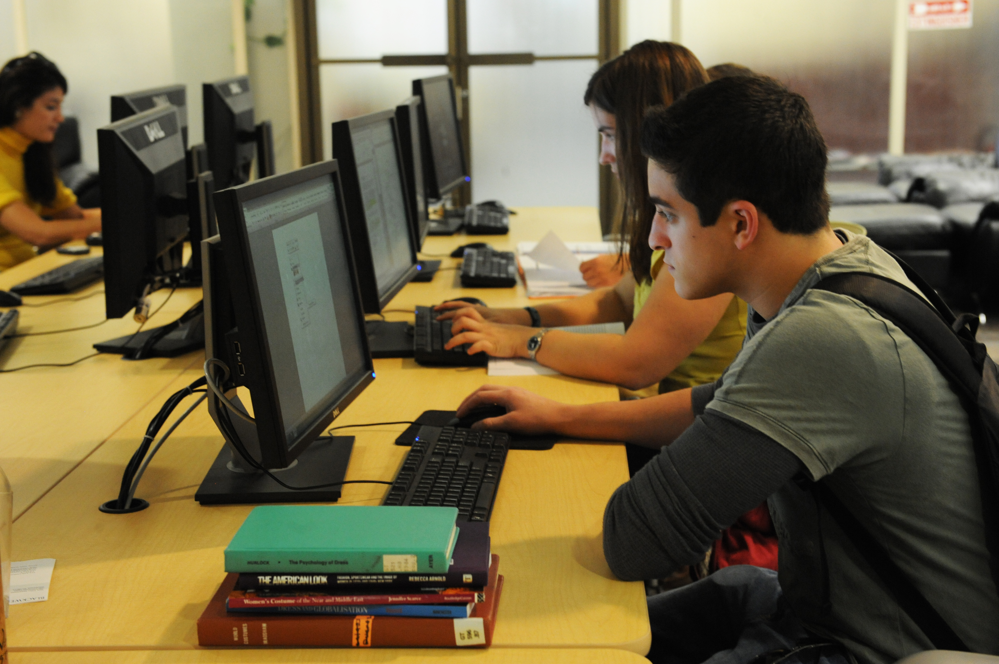
A digital divide, which widens in rural and low-income areas, coupled with a national financial crisis means that libraries play a crucial role in bridging the gap between those with access to computers and the Internet, and those without.

Slide 13
Libraries providing access
100% of public libraries offer free public Internet access
90.5% of public libraries offer Wi-Fi
64.5% of public libraries report they are the only free provider of Internet access in their community
60.2% of libraries reported increased usage of workstations over the previous year

Slide 14
Workforce development

Slide 15
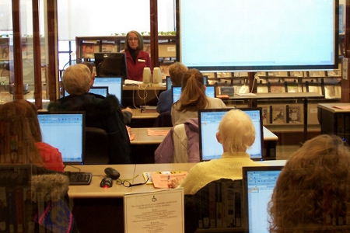
The vast majority of libraries provide programs that support people in
Applying for jobs (73 percent),
Access and using online job opportunity resources (68 percent),
Using online business information resources (48 percent);

Slide 16
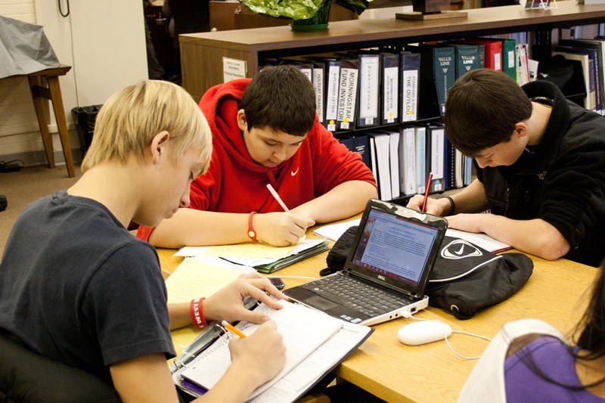
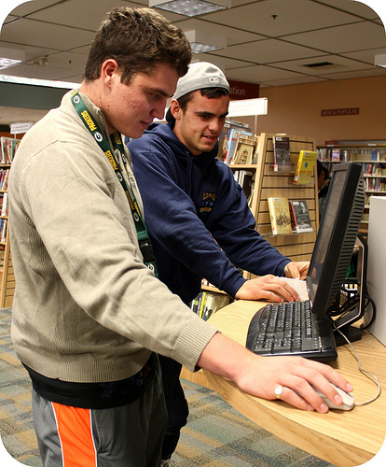
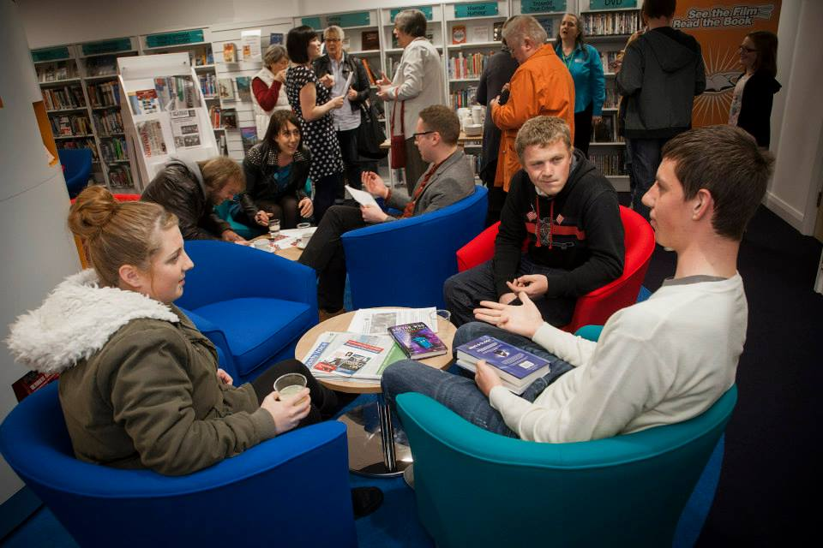

Slide 17
Libraries and innovation
Idea Boxes

Slide 18
Maker spaces —workshop areas that encourage tinkering and creating—and other interactive community spaces have been popping up in unexpected places. -

Slide 19
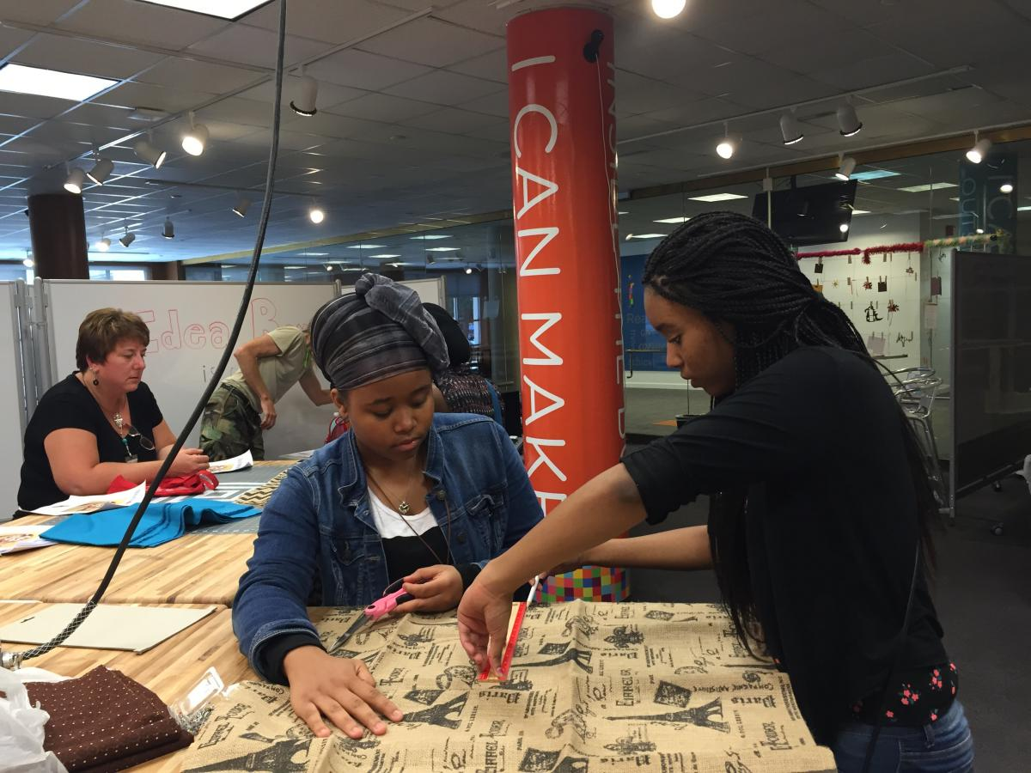
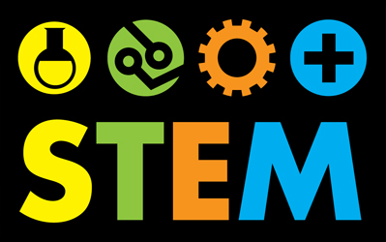
One of the newest homes for these collaborative environments has been in public libraries. Many of these spaces expose young learners to STEM skills, and help kids make the connection between what they learn in classrooms and real-world applications.

Slide 20
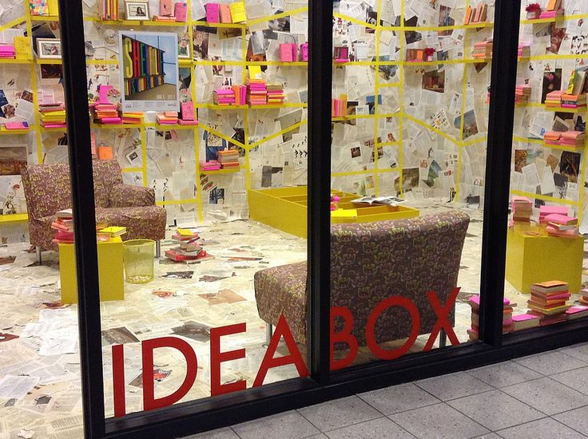
Inside a glass room in Main Library in uptown Charlotte, you’ll hear the whirring of machines. It’s the sound of learning and comes from “Idea Box,” a makerspace that opened to the public in 2015.

Slide 21
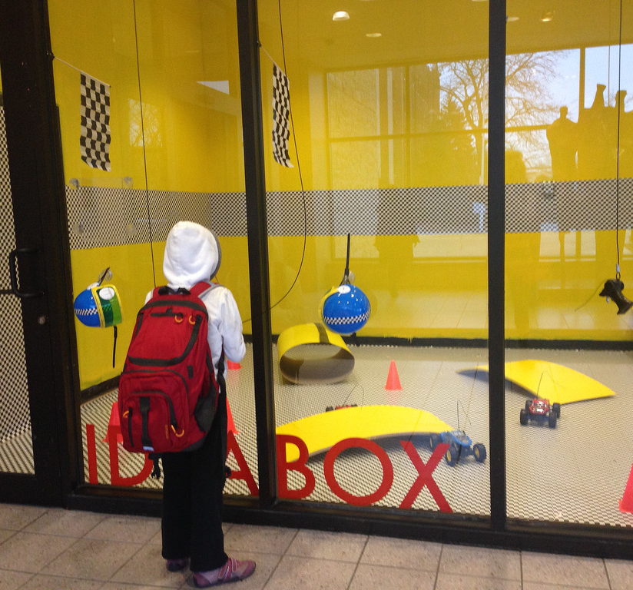
Oak park Public Library, Illinois

Slide 22
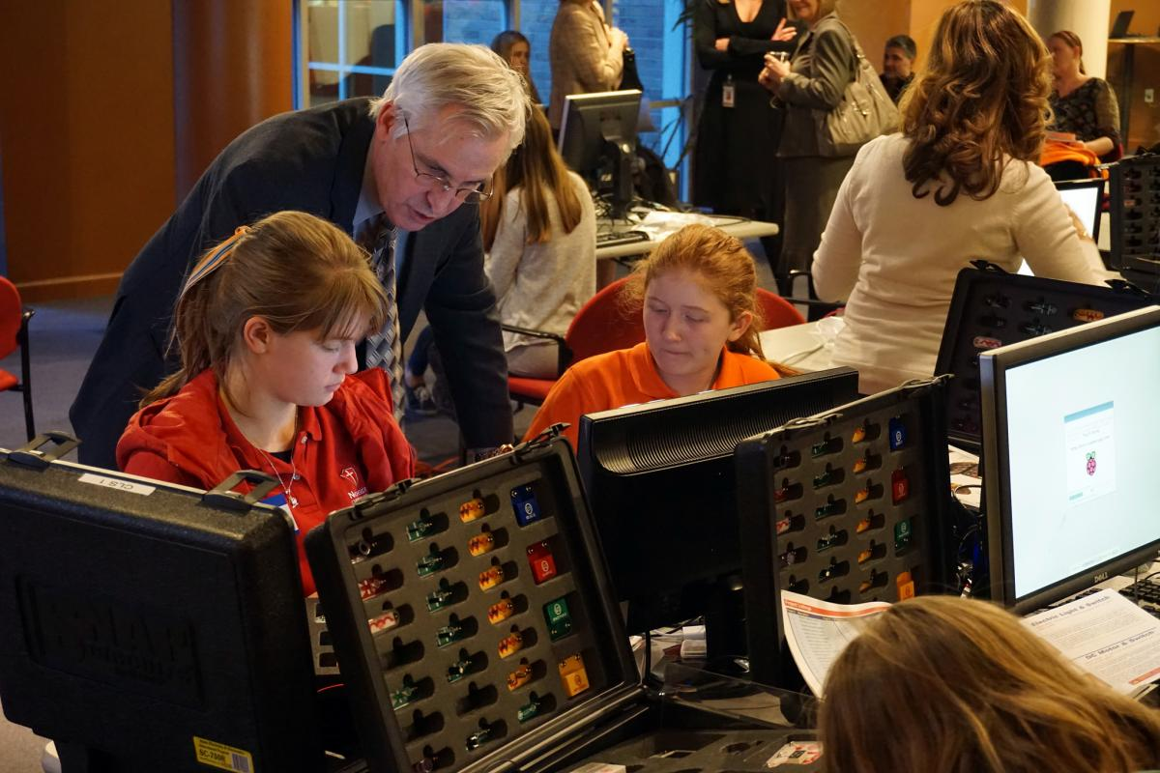

Slide 23
Libraries provide key services

Slide 24
Public librarians know their communities firsthand, and are often the first to recognize a pressing local need, simply because they interact on a daily basis with patrons from all walks of life.

Slide 25
This is not all. Libraries are expanding beyond their traditional roles and reaching further into their communities.

Slide 26
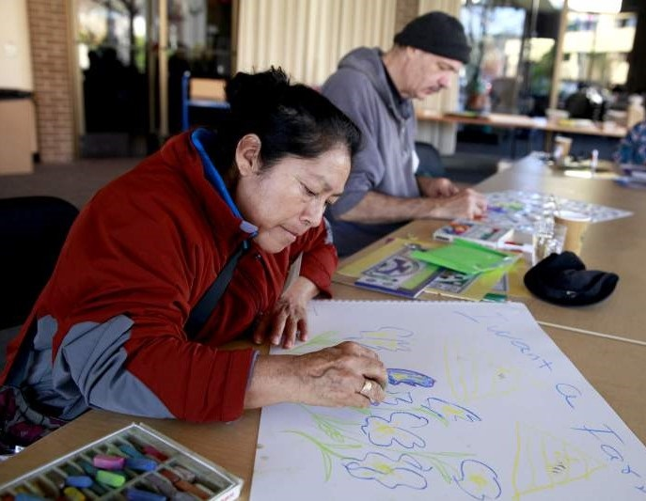
Seen and Heard Program in Santa Rosa 2015
Visual Histories of Homelessness in Sonoma County
Notes:
This program was made available for six months and offered a series of drop in art workshops for homeless and transitionally housed people.

Slide 27
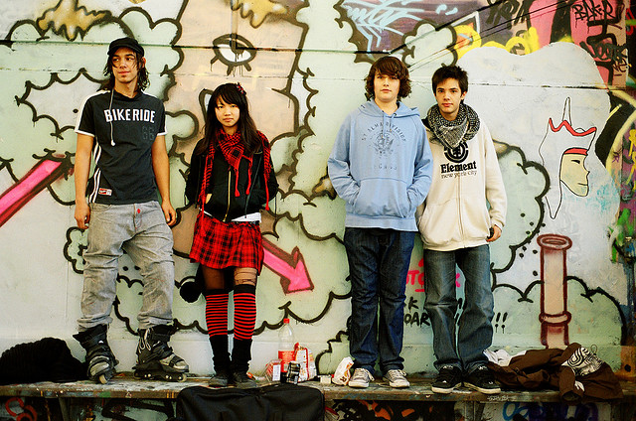
Library staff play a crucial role in connecting teens to the community agencies and individuals that can best meet their needs.

Slide 28
Once again, in the summer of 2016, the Sonoma County Library will be offering summer meals to children ages 0-18 through a partnership with the Redwood Empire Food Bank. Low income children who are eligible to receive a free lunch at school each day often go hungry when school is out during the summer. Summer meal programs like Lunch at the Library help ensure that these hungry children are fed.
Notes:
Over 500 kids were served last summer through this program

Slide 29
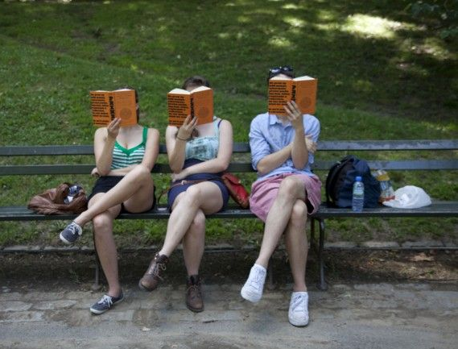
Library Summer Reading Programs Preventing Summer Learning Loss
When young people aren’t engaged in educational activities during the summer, they experience learning loss.
Sonoma County Library is preparing to take children, teens, and adults on a reading adventure this summer, beginning on June 7th.
Last year's program, "Every Hero Has a Story" had more than 5,300 children, 730 teens, and 1,100 adults participate.

Slide 30
Foundation mini grants program

Slide 31
Mini Grants Program
SCPLF Mini Grant’s Program was established in 2015.
Applicants apply for mini grants up to $2,000 for creative projects inspired by librarians. These are programs that are outside of the library’s operating budget.
Foundation sets aside $25,000 each year for this grant program. 3 grant cycles per year.

Slide 32
Build Clubs
Help Children Learn through play

Slide 33
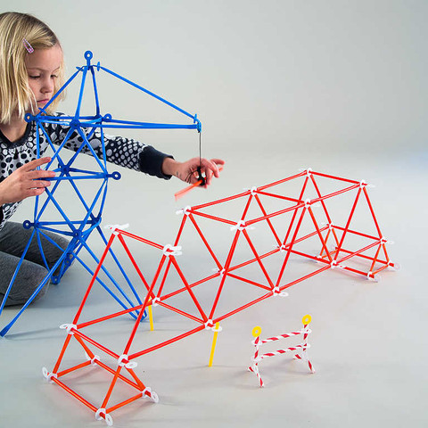
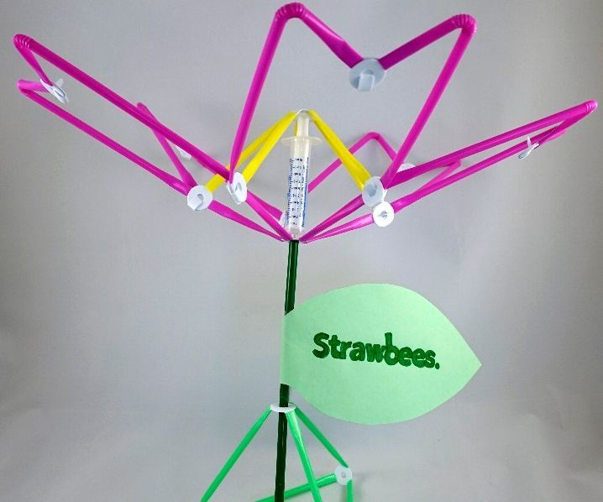
Several branches of Sonoma County Library are now offering monthly "Build Club" events, which are not only a fun and engaging activity for a variety of kids, but also are great opportunities for children to get hands-on engineering and problem-solving exercise with age-appropriate materials. Build Clubs are built on finite materials with infinite potential.

Slide 34
Teens in Action: Reading & Community Service
Middle school students will read a book that connects them with the engineering profession, crafted electronics, and to service in their community.
In Fall 2016, eighty seventh grade students at two local schools will read The Boy Who Harnessed the Wind by William Kamkwamba.

Slide 35
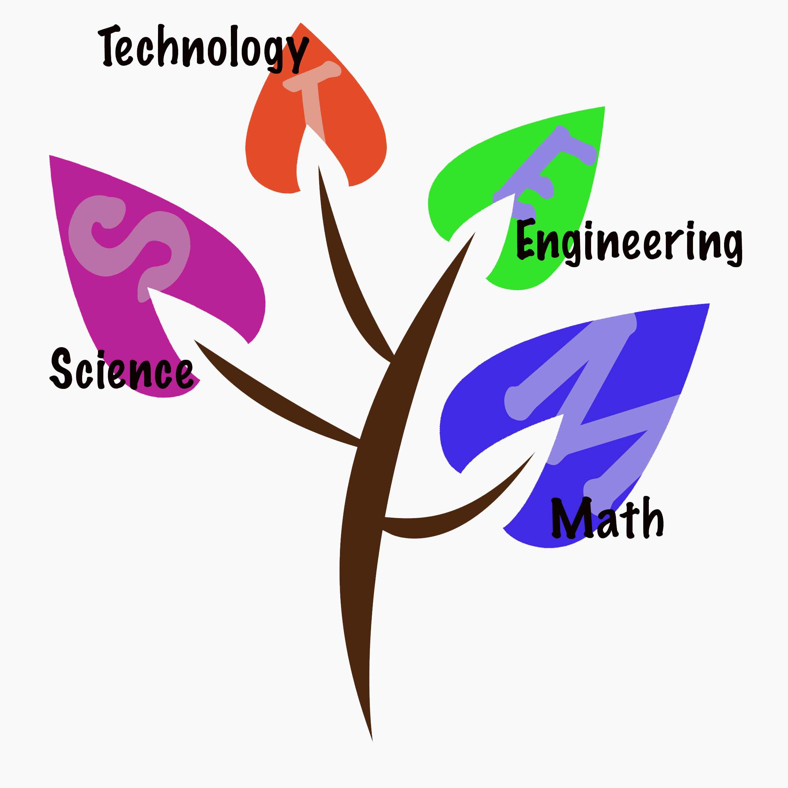
This project will focus on teaching students the basics of electrical current by creating electrified projects using conductive thread and LED lights (Digital Bling Bookmark craft). The Digital Bling kit will be gifted to the classrooms in order to give teachers the tools they need to support STEM education with their students.

Slide 36
The United States has developed as a global leader, in large part, through the genius and hard work of its scientists, engineers, and innovators.

Slide 37
Sonoma County Library

Slide 38
Welcomes over 2 million visitors each year
2 million people visit us online annually

Slide 39
About Our Local Libraries
14 Branch Libraries
222,400 active library cards
3.3 million items checked out in 2015
Library has a budget of 17 million
130 FTE
180 positions

Slide 40
30,000 children attend library reading and educational programs.

Slide 41
Challenges the library is facing
Sonoma County Library is operating with decreased revenues but has seen increased costs for books/materials.
Since 2011, the Library has had to cut hours by 25%
Many children’s educational classes/programs funded solely through volunteer fundraising, not the Library, due to lack of available funds
Overall access to our libraries has been reduced
Notes:
This is where the Foundation has played a key role in helping support programs for the library that otherwise would not have been funded

Slide 42
Effects on Children and Youth
Funding cuts have reduced our educational classes and events for the 30,000+ school and pre-school children who use our libraries each year.
Our libraries support and expand the mission of school libraries for students’ education, particularly as many schools have less funds for these types of services.

Slide 43
We need to maintain and improve children’s library
Homework help
Computer labs
Up-to-date children’s books/materials collections
Teacher resources
Summer reading clubs for children/teens
Creating opportunities for cooperative services between the Library and local schools

Slide 44
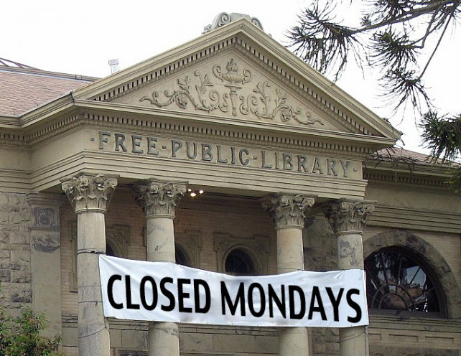
Improving Access
Additional funds would allow us to restore library hours and services at all local branches, improving access to this valuable community resource.
We must ensure library resources remain available for all.

Slide 45
What Can Be Done?
Any solution would need to include funds that will be controlled locally, for local libraries, and could not be taken by the State.
Sonoma County Library is completely separate from county government, is governed independently, and the County Board of Supervisors currently provides no funding for library services.
At this time, no sources of revenue exist to restore the library services our residents need.

Slide 46
Additional Funds Can Support Key Library Services
Keep qualified librarians
Maintain children’s books and materials
Maintain library facilities
Continue reading clubs and classes for children and teens
Provide safe places for children after school
Expand senior and disabled services
Restore library hours

Slide 47
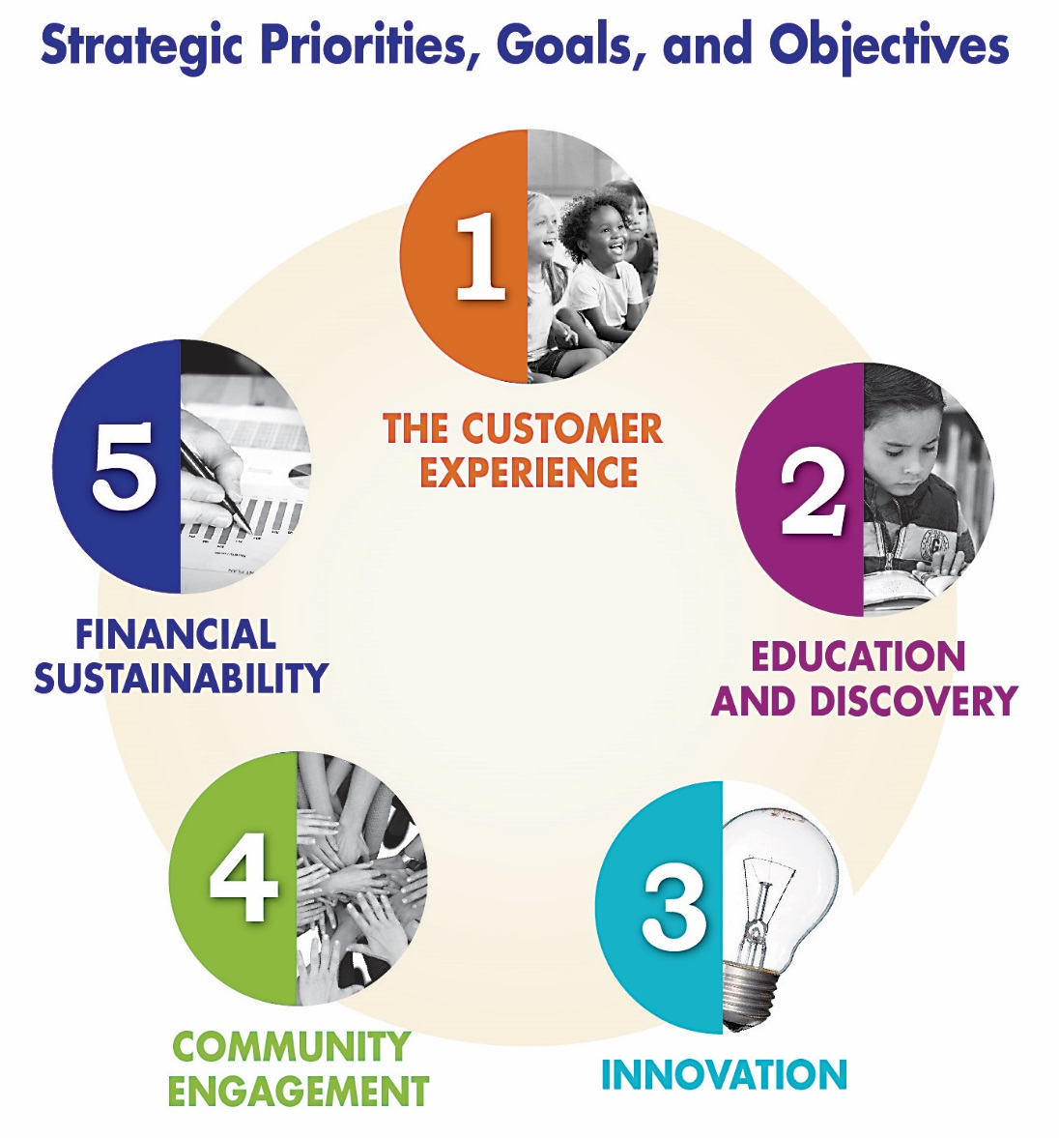
Recent Accomplishments
Sonoma County Library recently completed its Strategic Plan
Extensive involvement from residents to create a community-driven vision for local libraries
sonomalibrary.org/about/strategicplan

Slide 48
What are Your Priorities for Libraries?
The Library is working to implement its new strategic plan
sonomalibrary.org/about/strategicplan
We need your input!
Join the community conversation and let us know what’s most important to you.
Please complete the Community Feedback Survey.

Slide 49
“Google can bring you back 100,000 answers. A librarian can bring you back the right one.”
Neil Gaiman

